Slide 1
Reconocimiento de Arañas con CNN
Universidad Autónoma de Chihuahua
Machine Learning
Dr. Graciela
Estudiantes: Aketzalli García & Ericka Bermúdez

Slide 2

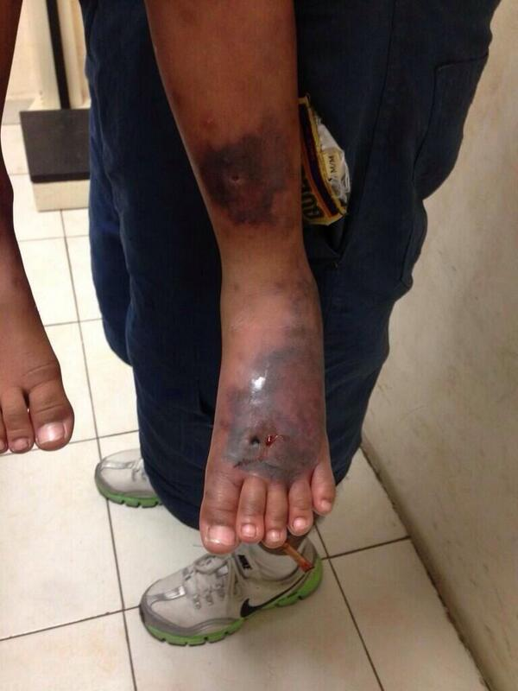
Importancia del tema
¿Por qué es importante poder reconocer una araña?

Slide 3
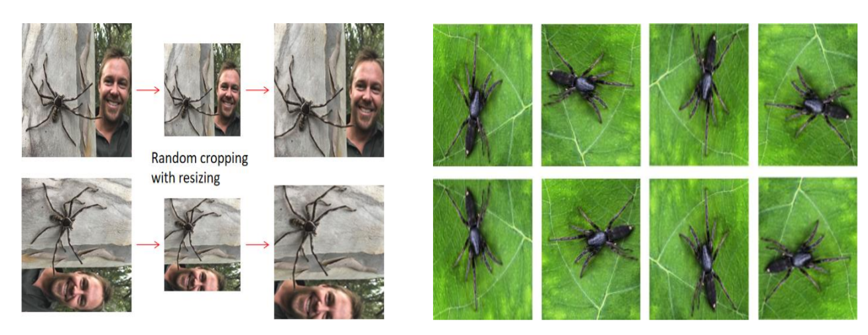
Trabajos relacionados
Sinnott, R. O., Yang, D., Ding, X., & Ye, Z. (2020). Poisonous Spider Recognition through Deep Learning. Proceedings of the Australasian Computer Science Week Multiconference, 04(6), 1–6
Data from Google Image Library. They had to filter the data to remove duplicates and irrelevant/inappropriate images. Then they realized data augmentation by rotating and flipping images.

Slide 4
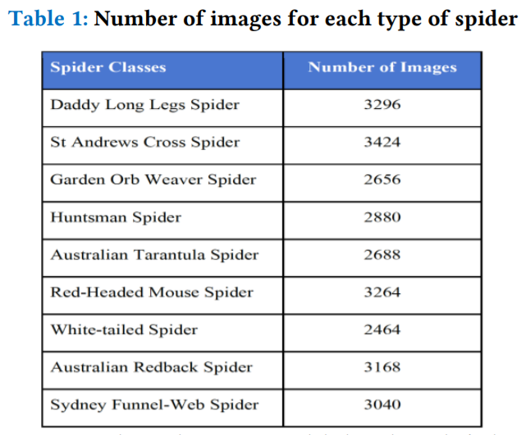
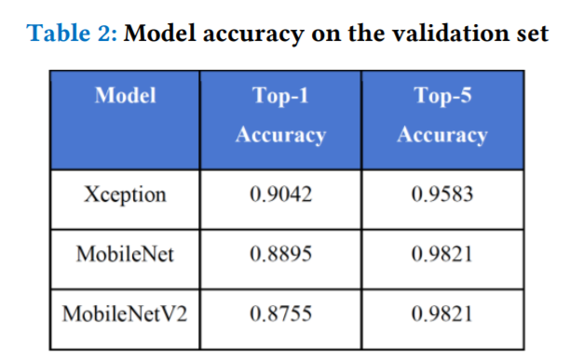

Slide 5
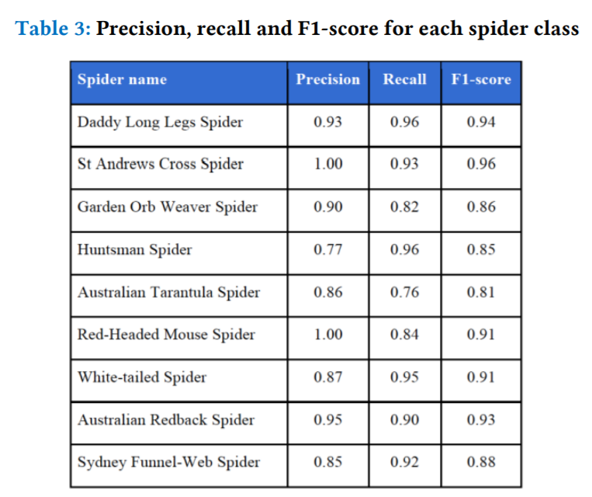

Slide 6
Modelo propuesto

Slide 7
Cronograma de actividades
Data Exploration
Literature review
Apply model
Parameter Tuning
Write results

Slide 8
Bibliografía
Fusto, G. (2020, October 2). Spider bites of medical significance in the Mediterranean area: misdiagnosis, clinical features and management. SciELO - Scientific Electronic Library Online. Retrieved October 20, 2021, from https://www.scielo.br/j/jvatitd/a/wQrfMGpmjygxpVBGSsFDgRp/?lang=en
Williams M, Anderson J, Nappe TM. Black Widow Spider Toxicity. [Updated 2021 Aug 11]. In: StatPearls [Internet]. Treasure Island (FL): StatPearls Publishing; 2021 Jan-. Available from: https://www.ncbi.nlm.nih.gov/books/NBK499987/

